Slide 1
CSP554 Big Data Technologies
NoSQL Databases: Cassandra

Slide 2


CASSANDRA
A.k.a Alexandra or Kassandra
Daughter of King Priam and Queen Hecuba of Troy.
Apollo gave her the power of prophecy to seduce her. She refused and then Apollo cursed her never to be believed.
https://en.wikipedia.org/wiki/Cassandra

Slide 3


CASSANDRA
Open Source distributed database management system
Initially developed at Facebook
Inspired by Amazon’s Dynamo and Google BigTable papers
Became Apache top-level project in Feb, 2010
Nowadays developed by DataStax

Slide 4


Cassandra is great for...
Massive, linear scaling
(e.g. CERN hadron collider, Barracuda Networks)
Extremely heavy writes
(e.g. BlueMountain Capital – financial tick data)
High availability
(e.g. eBay, Eventbrite, Netflix, SoundCloud, HeathCare Anytime, Comcast, GoDaddy, Sony Entertainment Network)
©2012 DataStax
13

Slide 5
Cassandra
•
A Linearly Scaling and Fault Tolerant Distributed Database
Node 1
Node 5
Node 2
•
Fully Distributed
Data spread over many nodes
All nodes participate in a cluster
All nodes are equal
No SPOF (shared nothing)
Node 4
Node 3
8
Node 1

Slide 6
Cassandra
•
Fault Tolerant
–
Nodes Down != Database Down
– Datacenter Down != Database Down

Slide 7

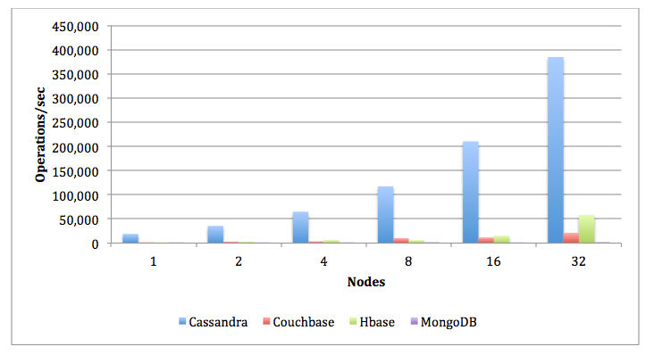
CASSANDRA
Fast Distributed NoSQL Database
High Availability
Linear Scalability => Predictability
No SPOF (single point of failure)
Multi-DC (data center)
Horizontally scalable
Not a drop in replacement for RDBMS

Slide 8
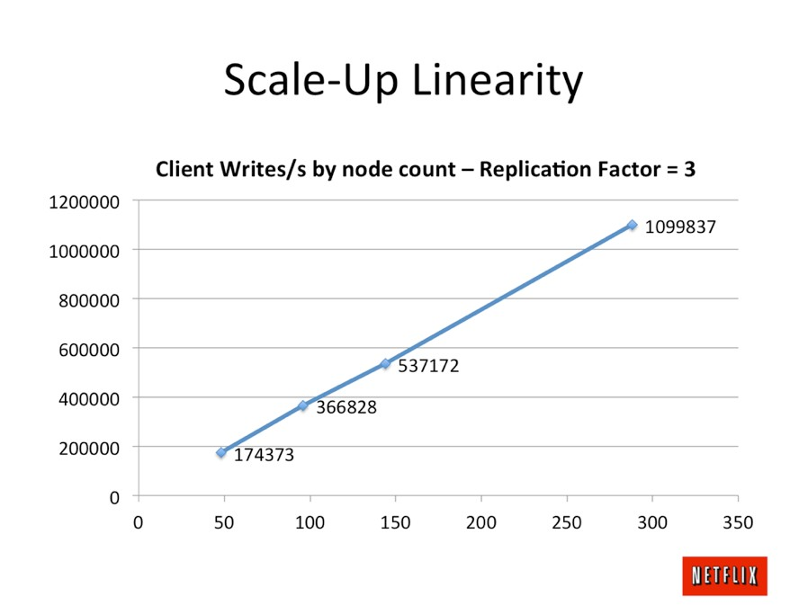
©2012 DataStax
14

Slide 9




Cassandra
•
•
•
•
Fully Replicated Clients write local
Data syncs across WAN Replication Factor per DC
Client
US
Europe

Slide 10
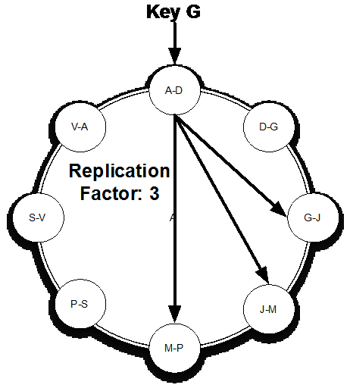
REPLICATION FACTOR
How many copies (replicas) for your data

Slide 11
What technology does Cassandra use to model data?
CQL: Cassandra Query Language

Slide 12



CQL
Familiar row-column SQL-like approach.
INSERT INTO users (id, name, surname, birthdate) VALUES (uuid(), ‘Carlos’,‘Alonso’, ’1985-03-19’);
CREATE TABLE users ( id UUID,
name VARCHAR, surname VARCHAR, birthdate TIMESTAMP, PRIMARY KEY(id)
);
SELECT * FROM users WHERE
id = ‘f81d4fae-7dec-11d0-a765-00a0c91e6bf6’;
ALTER TABLE users ADD address VARCHAR;

Slide 13
How Do Databases Scale Horizontally?
Imagine we have a table of user information with hundreds of millions of records, each with a unique id.
Further imagine that the size of this table was greater than the storage capability of any single Server or EC2 instance
Id | name | email
123 | Sam | Sam@gmail.com
456 | Joe | Joe@iit.com
789 | Ali | Ali@yahoo.com
… | … | …
CREATE TABLE users {
id INT,
name TEXT,
email TEXT,
PRIMARY KEY (id)
};

Slide 14
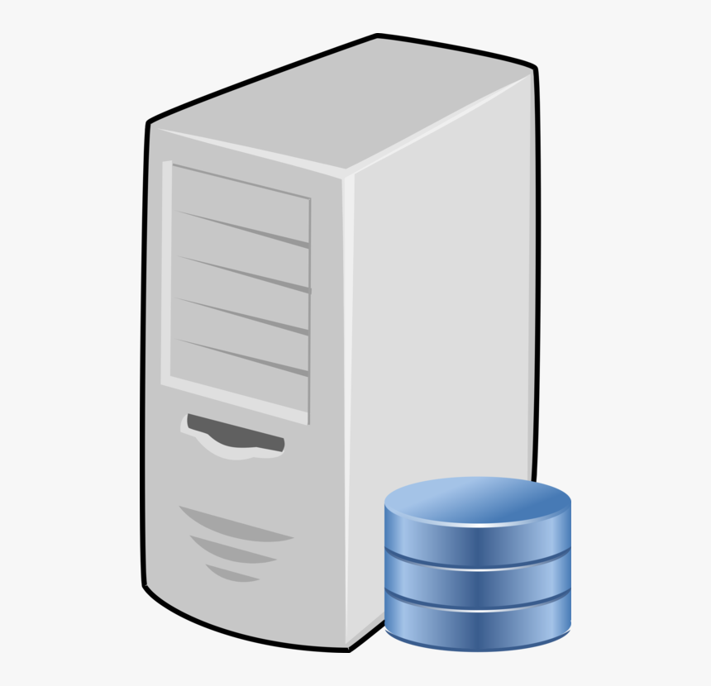
How Do Databases Scale Horizontally?
One approach is to divide the table up into parts or partitions where each partition is stored and processed by a different server or VM of a cluster
Id | name | email
… | … | …
Id | name | email
… | … | …
Id | name | email
… | … | …
Id | name | email
… | … | …

Slide 15
How Do Databases Scale Horizontally?
Two questions…
How do we assign each user record to a partition so no partition gets too many records
When we want to query or update a record how can we QUICKLY go and find which partition it is in
Id | name | email
… | … | …
Id | name | email
… | … | …
Id | name | email
… | … | …
Id | name | email
… | … | …

Slide 16
How Do Databases Scale Horizontally?
Now let’s imagine…
We have a function H that takes as input a number or string, a sequence of bytes, and outputs in integer between 1 and 1,000,000
output_value_between_1_and_1000000 = H(number or string)
We have assigned a range of these numbers to each partition (server or VM) as indicated below
1 – 250,000
250,001 – 500,000
500,001 – 750,000
750,001 – 1,000,000
Id | name | email
… | … | …
Id | name | email
… | … | …
Id | name | email
… | … | …
Id | name | email
… | … | …

Slide 17
How Do Databases Scale Horizontally?
So now we apply our function H to the id field of each record as follows and map the record to the appropriate partition
Id | name | email
123 | Sam | Sam@gmail.com
456 | Joe | Joe@iit.com
789 | Ali | Ali@yahoo.com
H(123) = | 300,850
H(456) = | 125
H(789) = | 800,503
1 – 250,000
250,001 – 500,000
500,001 – 750,000
750,001 – 1,000,000
Id | name | email
456 | Joe | Joe@…
… | … | …
Id | name | email
123 | Sam | Sam@...
… | … | …
Id | name | email
… | … | …
Id | name | email
789 | Ali | Ali@...
… | … | …

Slide 18
How Do Databases Scale Horizontally?
In this case the PRIMARY KEY, which is ‘id’, is also know as the partition key
Id | name | email
123 | Sam | Sam@gmail.com
456 | Joe | Joe@iit.com
789 | Ali | Ali@yahoo.com
H(123) = | 300,850
H(456) = | 125
H(789) = | 800,503
CREATE TABLE users {
id INT,
name TEXT,
email TEXT,
PRIMARY KEY (id)
};
← Partition key
1 – 250,000
250,001 – 500,000
500,001 – 750,000
750,001 – 1,000,000
Id | name | email
456 | Joe | Joe@…
… | … | …
Id | name | email
123 | Sam | Sam@...
… | … | …
Id | name | email
… | … | …
Id | name | email
789 | Ali | Ali@...
… | … | …

Slide 19
How Do Databases Scale Horizontally?
In Cassandra you must always identify the partition key in a query:
SELECT name, email FROM users WHERE id = 123;
Cassandra applies the H function to the given partition key to locate the partition holding the record of interest
1 – 250,000
250,001 – 500,000
500,001 – 750,000
750,001 – 1,000,000
Id | name | email
456 | Joe | Joe@…
… | … | …
Id | name | email
123 | Sam | Sam@...
… | … | …
Id | name | email
… | … | …
Id | name | email
789 | Ali | Ali@...
… | … | …

Slide 20
How Do Databases Scale Horizontally?
Why does Cassandra not allow this…
SELECT name, email FROM users WHERE id > 100 and < 200;
Because H(100) = 305, H(101) = 600,430 etc. That is, close together id’s are spread across many separate partitions and the query would be too inefficient
1 – 250,000
250,001 – 500,000
500,001 – 750,000
750,001 – 1,000,000
Id | name | email
456 | Joe | Joe@…
… | … | …
Id | name | email
123 | Sam | Sam@...
… | … | …
Id | name | email
… | … | …
Id | name | email
789 | Ali | Ali@...
… | … | …

Slide 21
How Do Databases Scale Horizontally?
So in the case of a simple primary key Cassandra allows for very fast single record create, update and reads but not much more. Is that all it can do?
Id | name | email
123 | Sam | Sam@gmail.com
456 | Joe | Joe@iit.com
789 | Ali | Ali@yahoo.com
SELECT name, email
FROM users
WHERE id = ?
SELECT name, email
FROM users
WHERE id IN (?, ?)
CREATE TABLE users {
id INT,
name TEXT,
email TEXT,
PRIMARY KEY (id)
};
← Partition key
1 – 250,000
250,001 – 500,000
500,001 – 750,000
750,001 – 1,000,000
Id | name | email
456 | Joe | Joe@…
… | … | …
Id | name | email
123 | Sam | Sam@...
… | … | …
Id | name | email
… | … | …
Id | name | email
789 | Ali | Ali@...
… | … | …

Slide 22
How Do Databases Scale Horizontally?
Imagine we have a composite primary key… that is, each record is uniquely identified by a combination of two or more attributes
Here each record is uniquely identified by a combination of id and year
Id | Year | weight
123 | 2018 | 150
123 | 2019 | 154
456 | 2018 | 185
456 | 2019 | 195
… | … | …
CREATE TABLE users {
id INT,
year INT,
weight int,
PRIMARY KEY (id, year)
};

Slide 23
How Do Databases Scale Horizontally?
The first attribute of the primary key (id) is still used to determine the partition as before
Id | year | weight
123 | 2018 | 150
123 | 2019 | 154
456 | 2018 | 185
456 | 2019 | 195
H(123) = | 300,850
H(456) = | 300,659
H(456) = | 125
H(456) = | 125
CREATE TABLE users {
id INT,
year INT,
weight int,
PRIMARY KEY (id, year)
};
Partition key
1 – 250,000
250,001 – 500,000
500,001 – 750,000
750,001 – 1,000,000
Id | year | weight
456 | 2018 | 185
456` | 2019 | 195
… | … | …
Id | year | weight
123 | 2018 | 150
123 | 2019 | 154
… | … | …
Id | year | Weight
… | … | …
Id | year | weight
… | … | …

Slide 24
How Do Databases Scale Horizontally?
But the second attribute of the primary key (year) is used to physically group or cluster together all the records in a partition sharing the same partition key
Id | year | weight
123 | 2018 | 150
123 | 2019 | 154
456 | 2018 | 185
456 | 2019 | 195
H(123) = | 300,850
H(456) = | 300,659
H(456) = | 125
H(456) = | 125
CREATE TABLE users {
id INT,
year INT,
weight int,
PRIMARY KEY (id, year)
};
Partition key
Cluster key
1 – 250,000
250,001 – 500,000
500,001 – 750,000
750,001 – 1,000,000
Id | year | weight
456 | 2018 | 185
456` | 2019 | 195
… | … | …
Id | year | weight
123 | 2018 | 150
123 | 2019 | 154
… | … | …
Id | year | Weight
… | … | …
Id | year | weight
… | … | …

Slide 25
How Do Databases Scale Horizontally?
The cluster key can be used for richer queries across records within a single partition
Id | year | weight
123 | 2018 | 150
123 | 2019 | 154
456 | 2018 | 185
456 | 2019 | 195
SELECT weight
FROM users
WHERE id = 123 AND ((year > 2017) AND (year < 2020))
ORDER BY year DESC;
1 – 250,000
250,001 – 500,000
500,001 – 750,000
750,001 – 1,000,000
Id | year | weight
456 | 2018 | 185
456` | 2019 | 195
… | … | …
Id | year | weight
123 | 2018 | 150
123 | 2019 | 154
… | … | …
Id | year | Weight
… | … | …
Id | year | weight
… | … | …

Slide 26
THE PARTITIONER
System running on each node that computes hashes through a hash function.
Various partitioners available.
Default is murmur3
All nodes MUST use the same!!!!
“Carlos”
185664
Hash function
1773456738847666528349
-894763734895827651234

Slide 27
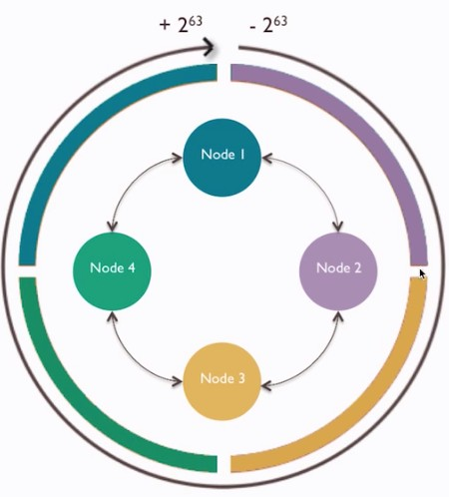
CONSISTENT HASHING
Data is stored in partitions, identified by a unique token within the range
(-2^63 - 2^63)
Nodes contain partition ranges.

Slide 28
Storing Data Using a Partition Key
PRIMARY KEY
PARTITION KEY
z
CREATE TABLE info (
country VARCHAR,
population INT,
PRIMARY KEY(country,)
);
COUNTRY | POPULATION
UNITED STATES | 4,000,000
UNITED STATES | 8,000,000
CANADA | 2,000,000
MEXICO | 350,000
PARTITIONER
Uses the hash of a partition key to decide to which node a record will be written
UNITED STATES | 4,000,000
UNITED STATES | 8,000,000
NODE 1
CANADA | 2,000,000
NODE 2
MEXICO | 350,000
NODE 3

Slide 29
Storing Data Using Partition and Sort/Cluster Keys
PRIMARY KEY
PARTITION KEY CLUSTER/SORT KEY
CREATE TABLE info (
country VARCHAR,,
state VARCHAR,
population INT,
PRIMARY KEY(country, state)
);
COUNTRY | STATE | POPULATION
UNITED STATES | NEW YORK | 8,000,000
UNITED STATES | ILLINOIS | 4,000,000
CANADA | ONTERIO | 2,000,000
CANADA | QUEBEC | 1,000,000
MEXICO | BAJA | 350,000
Each record is sorted by the cluster/sort
key within a partition
PARTITIONER
UNITED STATES | ILLINOIS | 4,000,000
UNITED STATES | NEW YORK | 8,000,000
NODE 1
CANADA | ONTERIO | 2,000,000
CANADA | QUEBEC | 1,000,000
NODE 2
MEXICO | BAJA | 350,000
NODE 3

Slide 30
Which are the technological roots of Cassandra?
Google BigTable and Amazon Dynamo pulled together by developers at Facebook

Slide 31
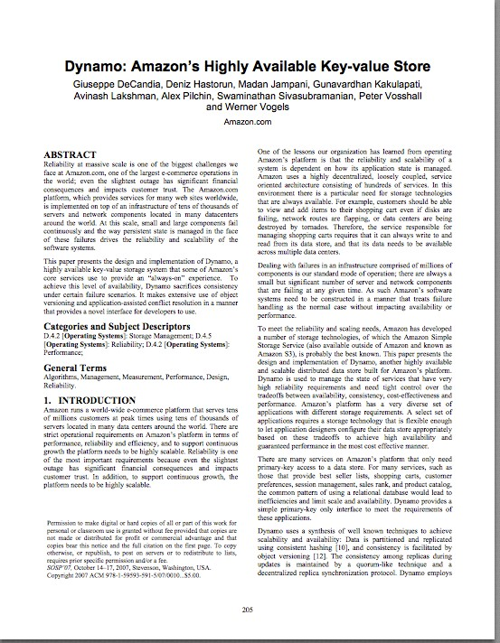

Dynamo Paper(2007)
How do we build a data store that is:
Reliable
Performant
“Always On”
Nothing new and shiny
24 papers cited
Also the basis for Riak and Voldemort

Slide 32
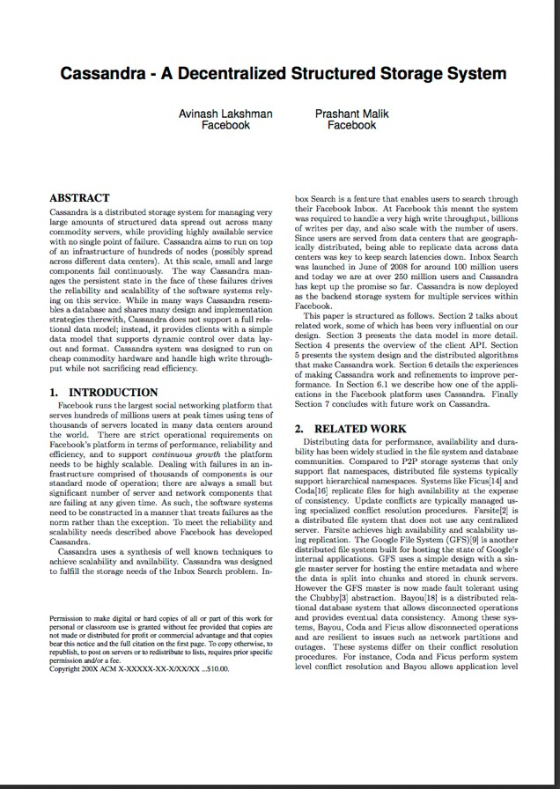
Cassandra(2008)
Distributed features of Dynamo
Data Model and storage from BigTable
February 17, 2010 it graduated to a top-level Apache project

Slide 33

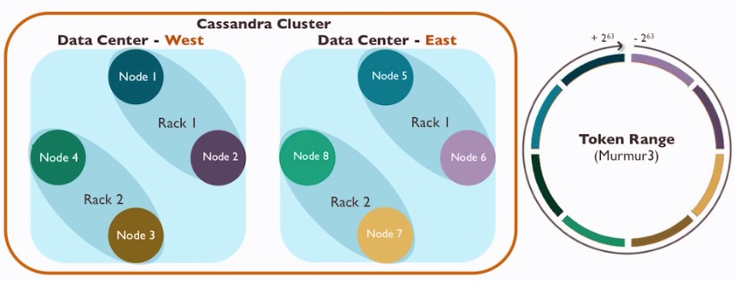
CASSANDRA CLUSTER

Slide 34
What do consistency, availability and partition tolerance mean?
Consistency: All clients have the exact same value for the whole data set at any given point.
Availability: All clients can read and write to the system at any given point.
Partition tolerance: Whether or not the system tolerates a node being disconnected from the system.

Slide 35
Where does Cassandra fit within the CAP Theorem?
AP
Cassandra trades off consistency in order to guarantee availability and partition tolerance, but in a configurable way, so it’s up to the developer where to sit for each query.

Slide 36


Two knobs control Cassandra fault tolerance
•
Replication Factor (server side)
– How many copies of the data should exist?
RF=3
A
CD
B
AD
Write A
Client
D
BC
C
AB

Slide 37


Two knobs control Cassandra fault tolerance
•
Consistency Level (client side)
– How many replicas do we need to hear from before we acknowledge?
CL=ONE CL=QUORUM
A
CD
B
AD
A
CD
B
AD
Write A
Write A
Client
Client
D
BC
C
AB
D
BC
C
AB

Slide 38
Consistency Levels
•
Applies to both Reads and Writes (i.e. is set on each query)
ONE – one replica from any DC LOCAL_ONE – one replica from local DC QUORUM – 51% of replicas from any DC
LOCAL_QUORUM – 51% of replicas from local DC
ALL – all replicas

Slide 39


Consistency Level and Speed
•
How many replicas we need to hear from can affect how quickly we can read and write data in Cassandra
A
CD
B
AD
Read A (CL=QUORUM)
Client
5 µs ack
300 µs ack
12 µs ack
D
BC
C
AB
12 µs ack

Slide 40
Consistency Level and Availability
•
•
Consistency Level choice affects availability
For example, QUORUM can tolerate one replica being down and still be available (in RF=3)
A
CD
B
AD
Read A (CL=QUORUM)
Client
A=2
A=2
A=2
D
BC
C
AB

Slide 41

Writes in the cluster
•
•
Fully distributed, no SPOF
Node that receives a request is the Coordinator for request
•
Any node can act as Coordinator
A
CD
B
AD
Client
Write A (CL=ONE)
D
BC
C
AB
Coordinator Node

Slide 42
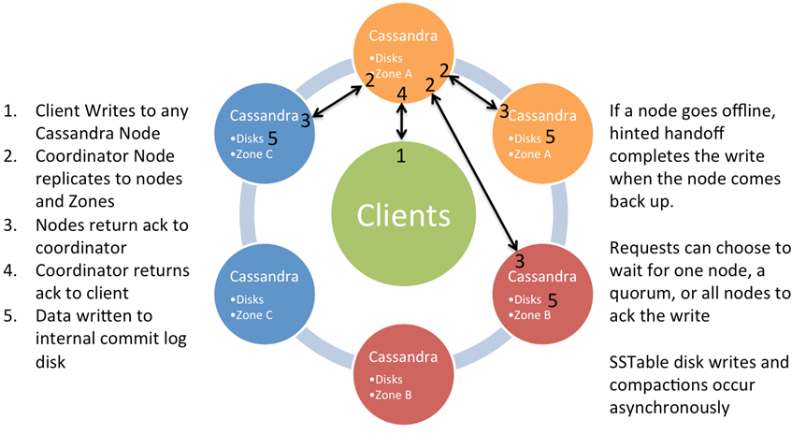
Write Behavior

Slide 43

Reads in the cluster
•
•
Same as writes in the cluster, reads are coordinated Any node can be the Coordinator Node
A
CD
B
AD
Client
Read A (CL=QUORUM)
D
BC
C
AB
Coordinator Node

Slide 44
Reads and Eventual Consistency
Cassandra is an AP system that is Eventually Consistent so replicas may disagree
Column values are timestamped
•
In Cassandra, Last Write Wins (LWW)
A
CD
B
AD
Read A
Client
(CL=QUORUM)
A=2
Newer
A=2
D
BC
C
AB
A=1
Older

Slide 45
Data Distribution
•
Partition Key determines node placement
CREATE TABLE users (
id text, firstname text, lastname text, PRIMARY KEY (id)
);
Partition Key
id='jhaddad'
firstname='Jon'
lastname='Haddad'
id='ltillman'
firstname='Luke'
lastname='Tillman'
id='pmcfadin'
lastname='McFadin'

Slide 46


Data Distribution
•
The Partition Key is hashed using a consistent hashing function and the output is used to place the data on a node
Partition Key
RF=3
id='ltillman'
firstname='Luke' lastname='Tillman'
A
CD
B
AD
id: ltillman
:A
D
BC
C
AB
•
The data is also replicated to RF-1 other nodes

Slide 47
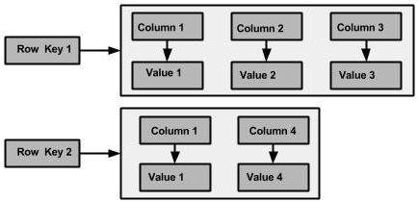
CASSANDRA DATA MODEL
Query driven data model
Column family non relational db

Slide 48
CQL
For a relational database…
The way you define a table schema does not force you to consider how data is stored physically in the database
But for Cassandra…
The way you define a schema actually impacts how data is distributed physically across the cluster

Slide 49
CQL Basics
Cassandra Query Language
SQL–like language to query Cassandra
Keyspace – analogous to a database
Has various storage attributes
Table – looks like a SQL Table.
A table exists within a keyspace
A table must have a Primary Key
We can fully qualify a table as <keyspace>.<table>
Cassandra Cluster
This_Key_Space
Other_Key_Space
Table_A
Table_B
Table_A
Table_B

Slide 50
CQL Basics - Keyspace
Create a keyspace for a cluster located in a single data center
Indicated by use of ‘SimpleStrategy’
Specify how many copies of each table’s data should exist across the cluster
Indicate by use of ‘replication_factor’
CREATE KEYSPACE cycling WITH REPLICATION =
{ 'class' : 'SimpleStrategy', 'replication_factor’ : 3 };

Slide 51
CQL Basics
Usual statements
CREATE / DROP / ALTER TABLE / SELECT
BUT
INSERT AND UPDATE are similar to each other
If a row doesn’t exist, UPDATE will insert it, and if it exists, INSERT will replace it.
Think of it as an UPSERT

Slide 52
CQL Basics – creating a table
CREATE TABLE cities (
city_name varchar,
elevation int,
population int,
museums int,
bridges int,
PRIMARY KEY (city_name)
);
We can visualize it this way:
city_name is the partition key
In this example, the partition key = primary key
city_name | elevation | population | museums | bridges
Springfield | 978 | 60456 | 23 | 8

Slide 53
CQL Basics –Primary Key
The Primary Key
The key uniquely identifies a row:
PRIMARY KEY (partition key)
A composite primary key consists of:
A partition key
One or more clustering columns (clustering keys)
PRIMARY KEY (partition key, cluster columns, ...)
The partition key determines on which node the partition resides
Data is ordered in cluster column (sorted) order within the partition

Slide 54
CQL Basics – Composite Primary Key
CREATE TABLE sporty_league (
team_name varchar,
player_name varchar,
jersey int,
PRIMARY KEY (team_name, player_name)
);

Slide 55
CQL Basics – Simple Select
SELECT * FROM sporty_league;
More that a few rows can be slow. (Limited to 10,000 rows by default)
Use LIMIT keyword to choose fewer or more rows

Slide 56
CQL Basics - Simple Select on Partition Key and Cluster Columns
SELECT * FROM sporty_league WHERE team_name = ‘Mighty Mutts’;
SELECT * FROM sporty_league WHERE team_name = ‘Mighty Mutts’ and player_name = ‘Lucky’;

Slide 57
CQL Basics – Insert/Update
INSERT INTO sporty_league
(team_name, player_name, jersey)
VALUES ('Mighty Mutts',’Felix’,90);
UPDATE sporty_league
SET jersey=85
WHERE team_name=‘Mighty Mutts’ and player_name=‘Felix’;

Slide 58
CQL Basics - Ordering
Partition keys are not ordered, but the cluster columns are.
However, you can only order by a column if it’s a cluster column.
Data will returned by default in the order of the clustering column.
You can also use the ORDER BY keyword – but only on the clustering column
SELECT * FROM sporty_league
WHERE team_name = ‘Mighty Mutts’
ORDER BY player_name DESC;

Slide 59
CQL Basics - Predicates
On the partition key: = and IN
On the cluster columns: <, <=, =, >=, >, IN

Slide 60
CQL Basics – ALLOW FILTERING
Let’s take for example the following table:
CREATE TABLE blogs (
blogId int,
time1 int,
time2 int,
author text,
content text,
PRIMARY KEY(blogId, time1, time2));
If you execute the following query:
SELECT * FROM blogs;
Cassandra will return you all the data that the table blogs contains

Slide 61
CQL Basics – ALLOW FILTERING
If you now want only the data at a specified time1, you will naturally add an equal condition on the column time1:
SELECT * FROM blogs WHERE time1 = 1418306451235;
In response, you will receive the following error message:
Bad Request: Cannot execute this query as it might involve data filtering and thus may have unpredictable performance. If you want to execute this query despite the performance unpredictability, use ALLOW FILTERING.
The only way Cassandra can execute this query is by retrieving all rows from all partitions of table blogs
And then by filtering out the ones which do not have the requested value for the time1 column

Slide 62
CQL Basics – ALLOW FILTERING
If you really want to execute such a query you need to use:
SELECT * FROM blogs WHERE time1 = 1418306451235 ALLOW FILTERING;
This indicates you realize the possible that the query will need to use filtering and might be (very) slow

Slide 63
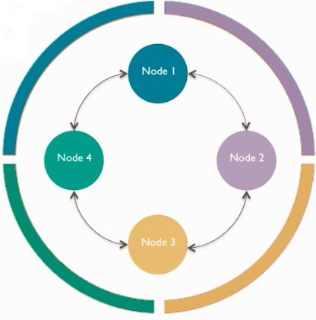
VNODES

Slide 64
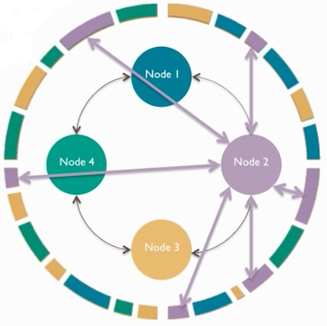
VNODES

Slide 65
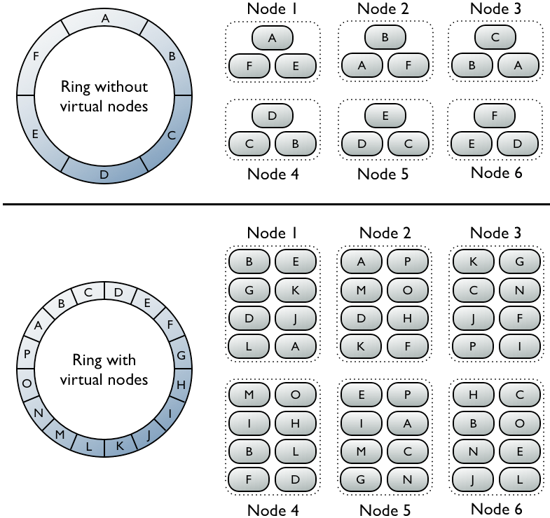

Slide 66
CASSANDRA:YES
If you need:
No SPOF
Linear horizontal scalability in commodity hardware
Real-time writes
Reliable data replication across distributed data centres
Clearly defined schema in a NoSQL environment

Slide 67
CASSANDRA: NO
If you need:
ACID transactions with rollback
Justification for high-end software

